Slide 1
Ai Biologist LLM data extraction to database for lab automation

Slide 2
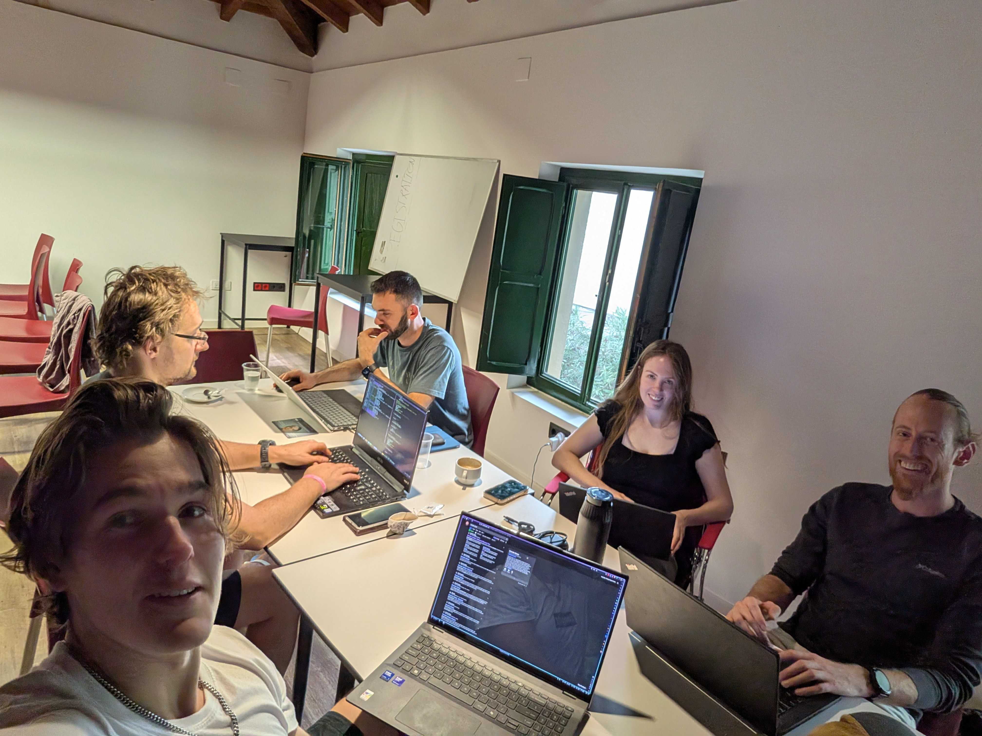

Slide 3
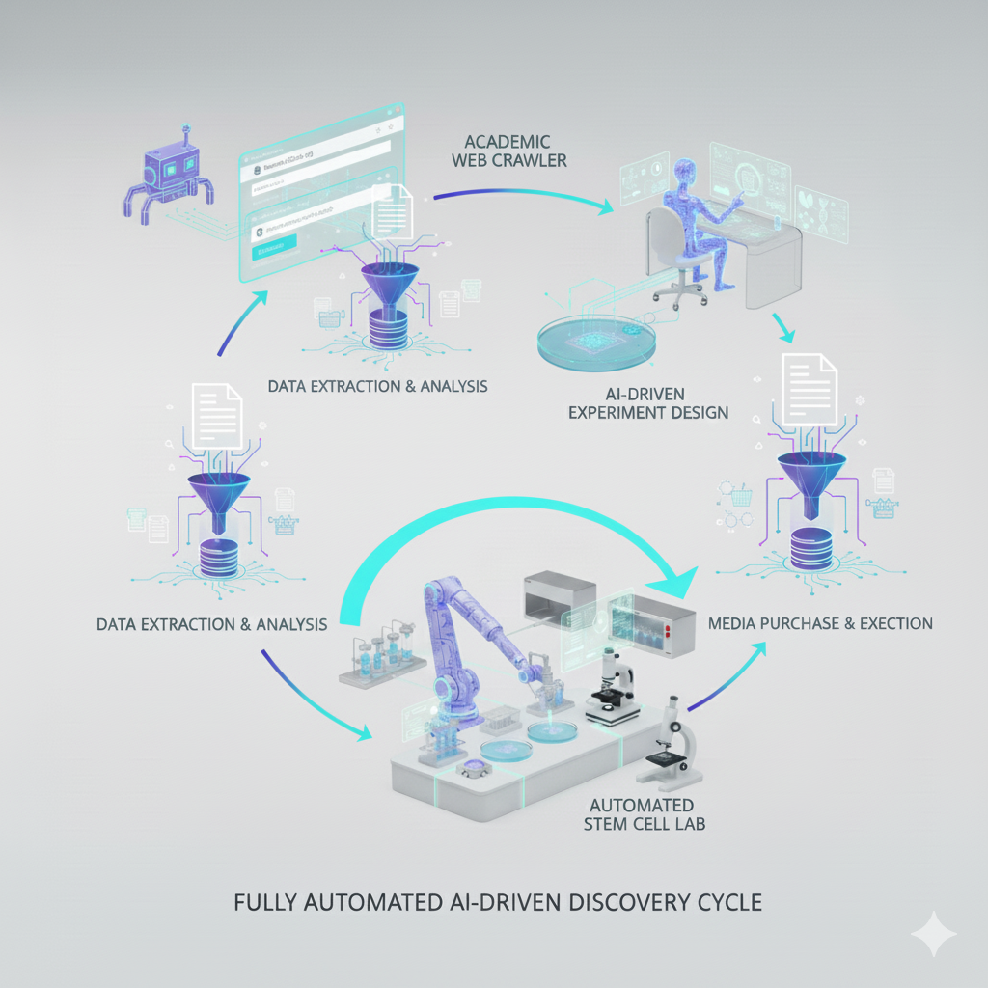
Automated Stem Cell Lab
Crawl Web
Extract Data
Structure Data
Design Experiments
Execute Experiments
Recursive Learning

Slide 4
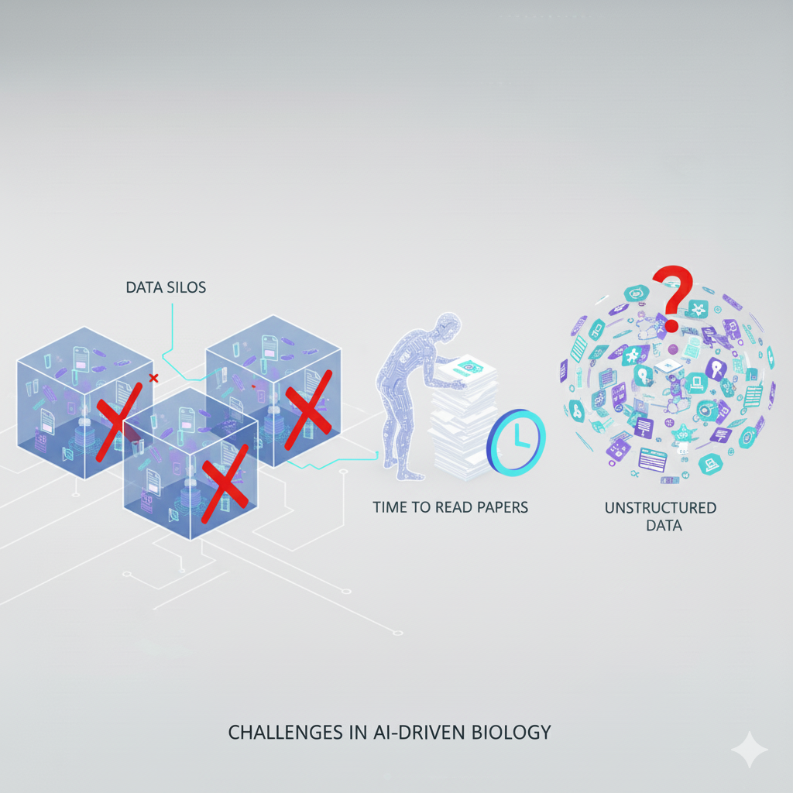
Problem
Data Silos
Reading Papers
Unstructured Data

Slide 5
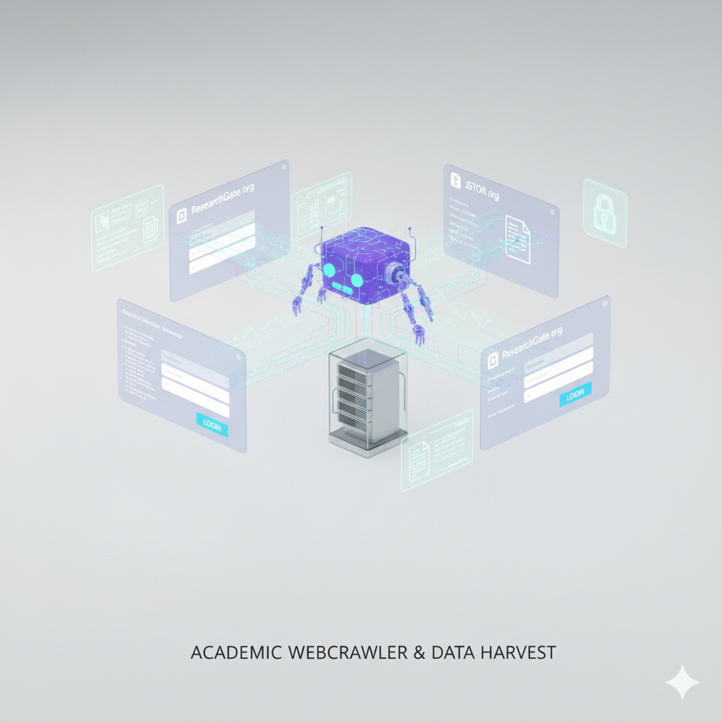
Web Crawler

Slide 6
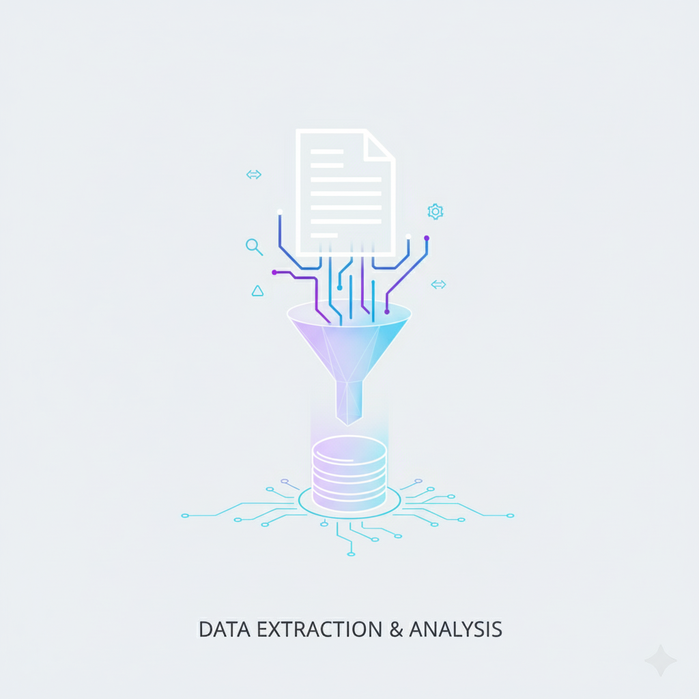
Extract Data

Slide 7
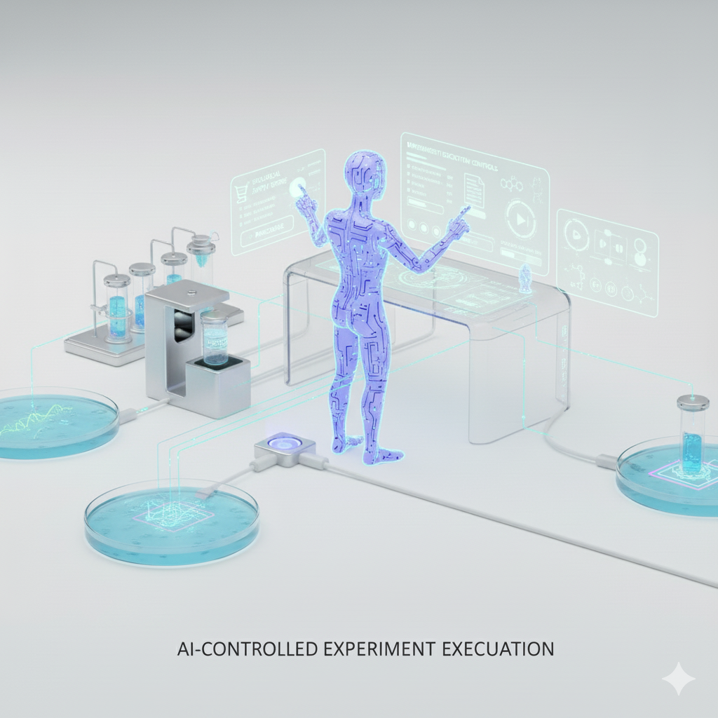
AI Experimental Design

Slide 8
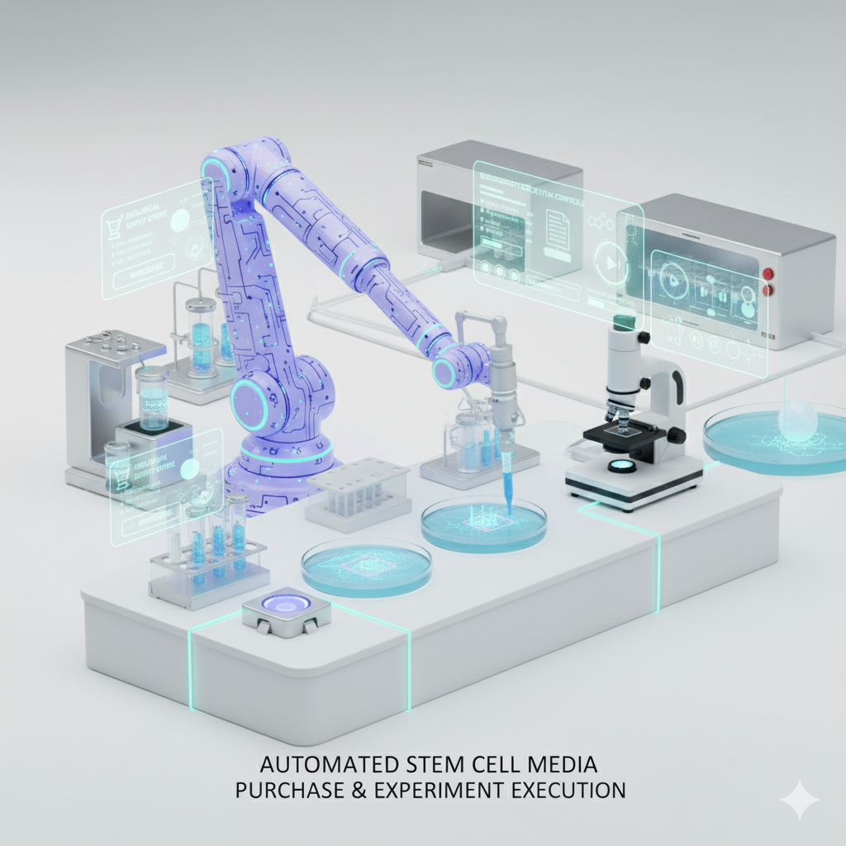
Execute Experiment

Slide 9
Recursive Learning

Slide 10
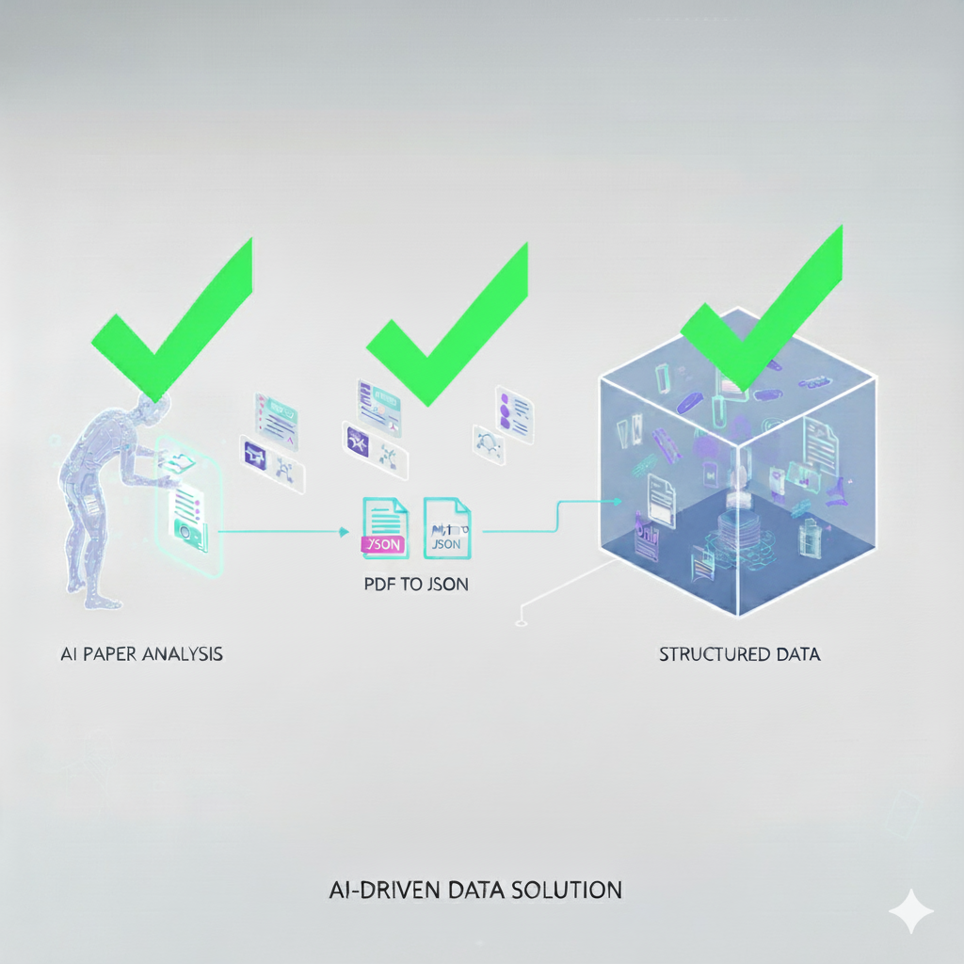
Extract Data
AI Paper Analysis
PDF to text
Structure DATA
Meta Data
Results
Methods

Slide 11
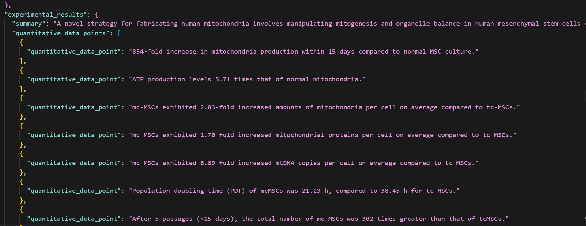

Slide 12
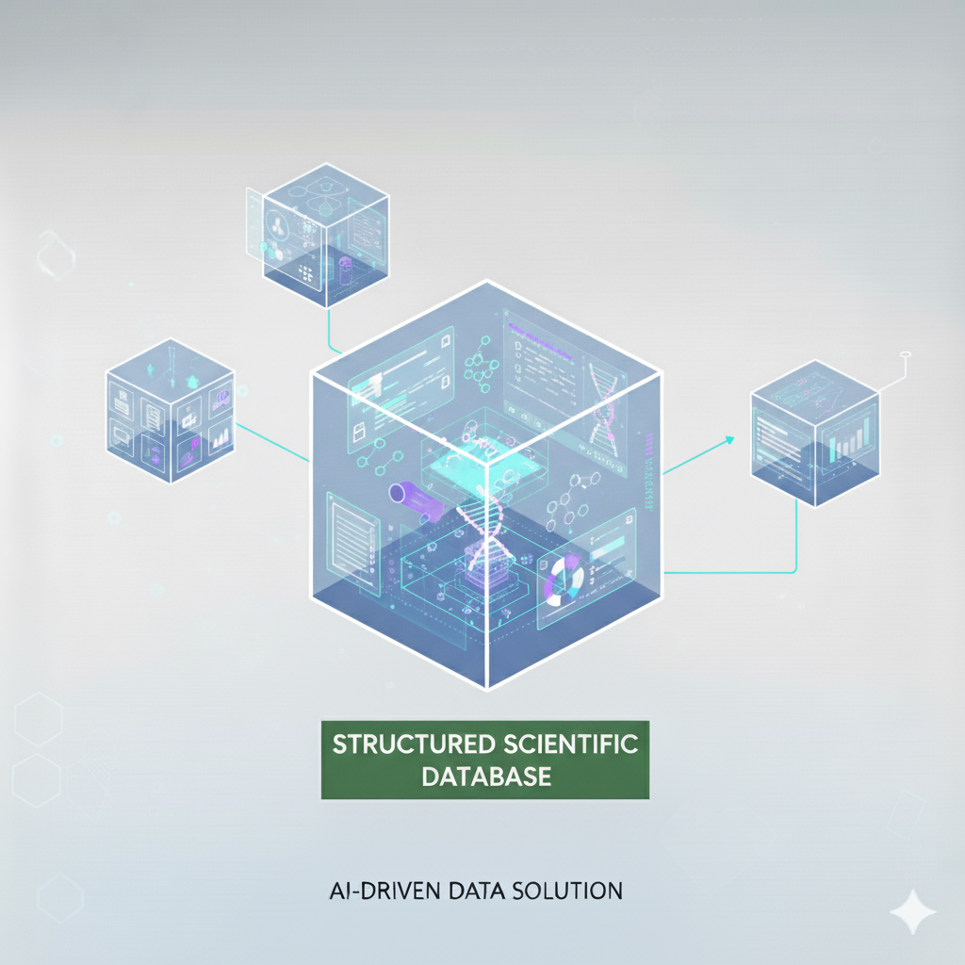
Structure Data

Slide 13
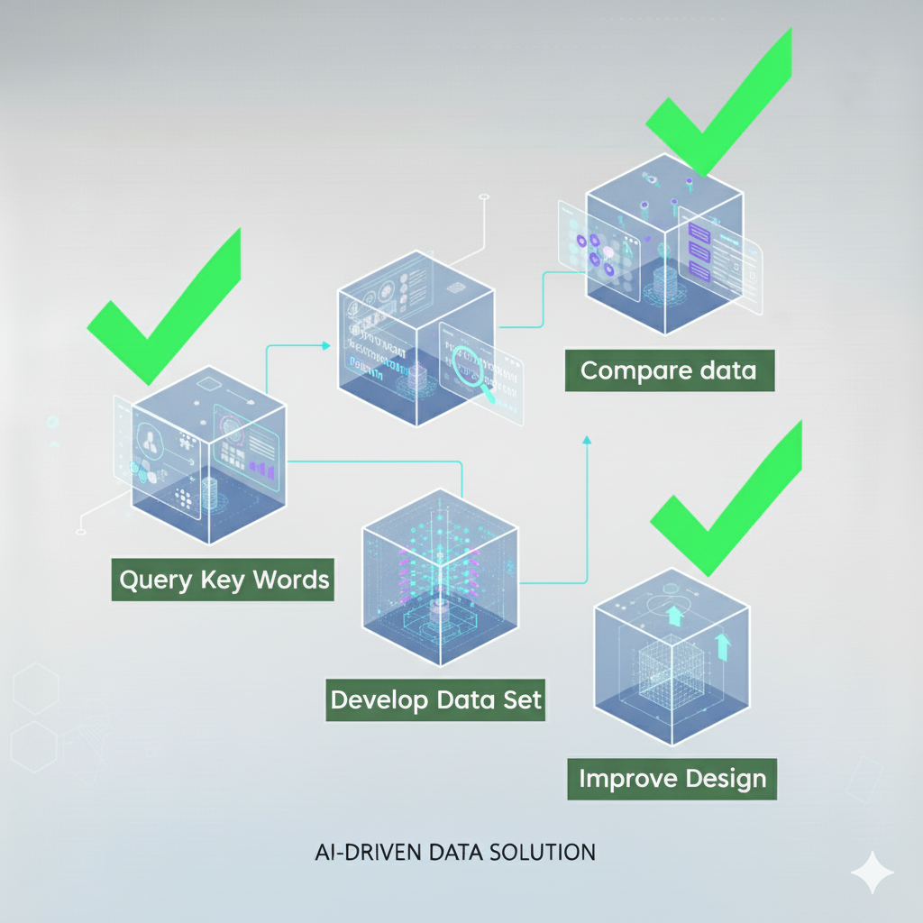
Query Data
Compare data
Query Key Words
Develop Data Set
Improve Design

Slide 14
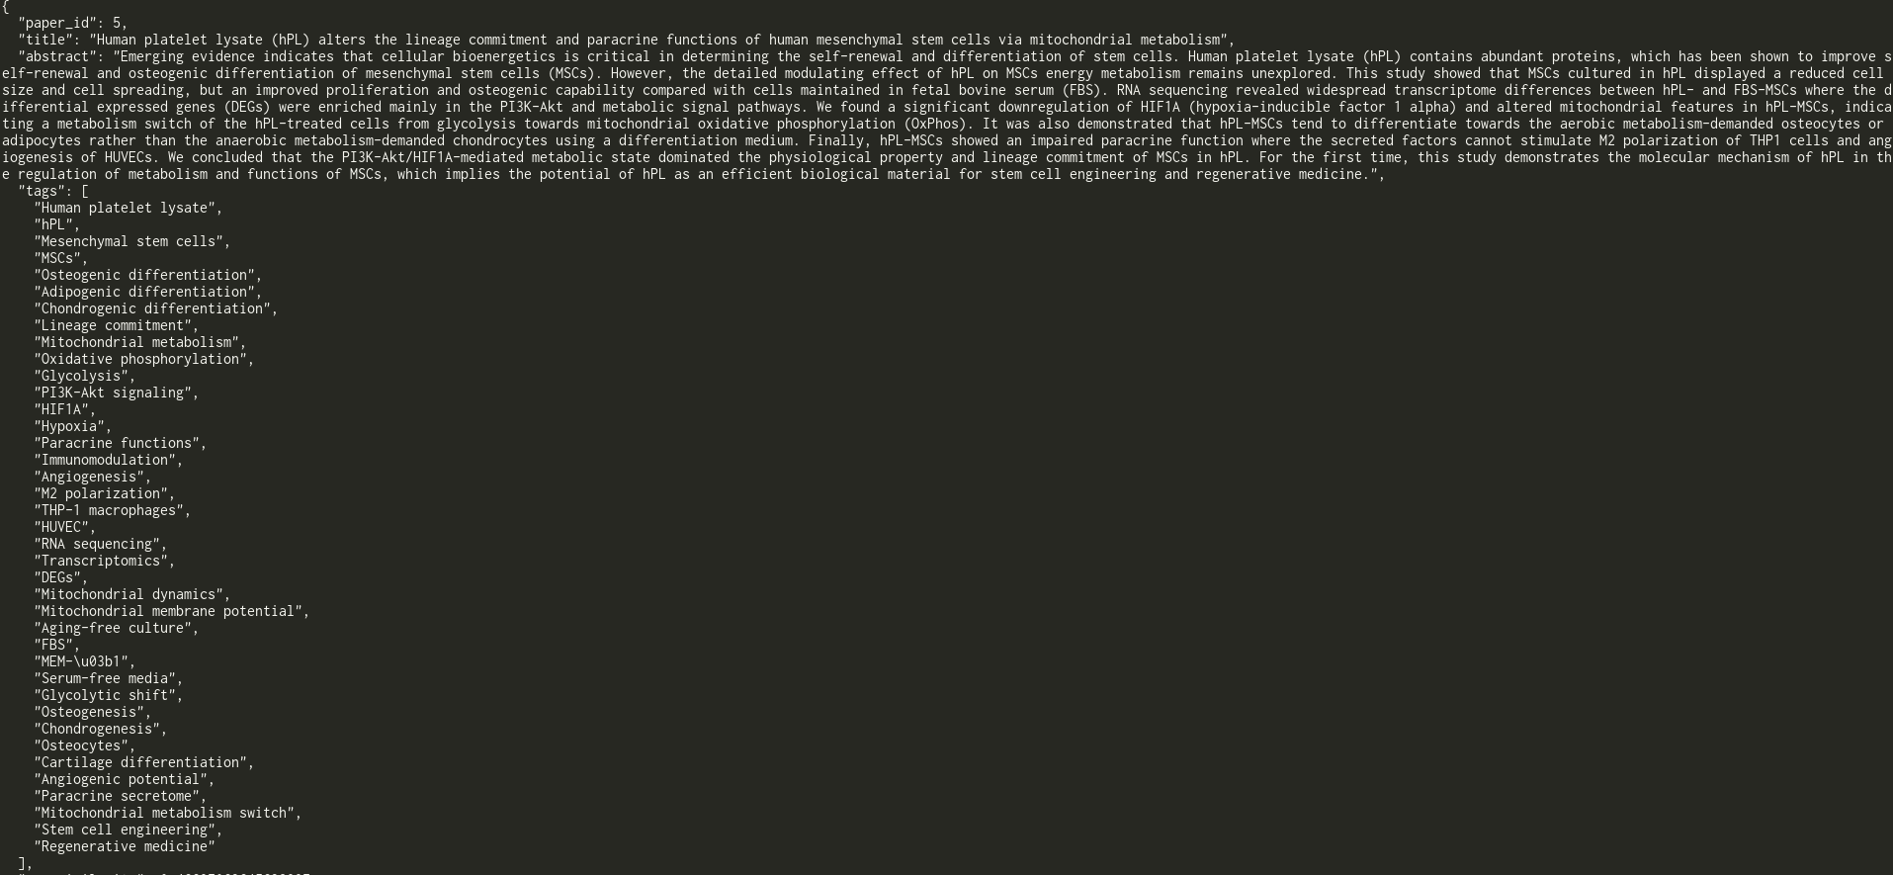

Slide 15
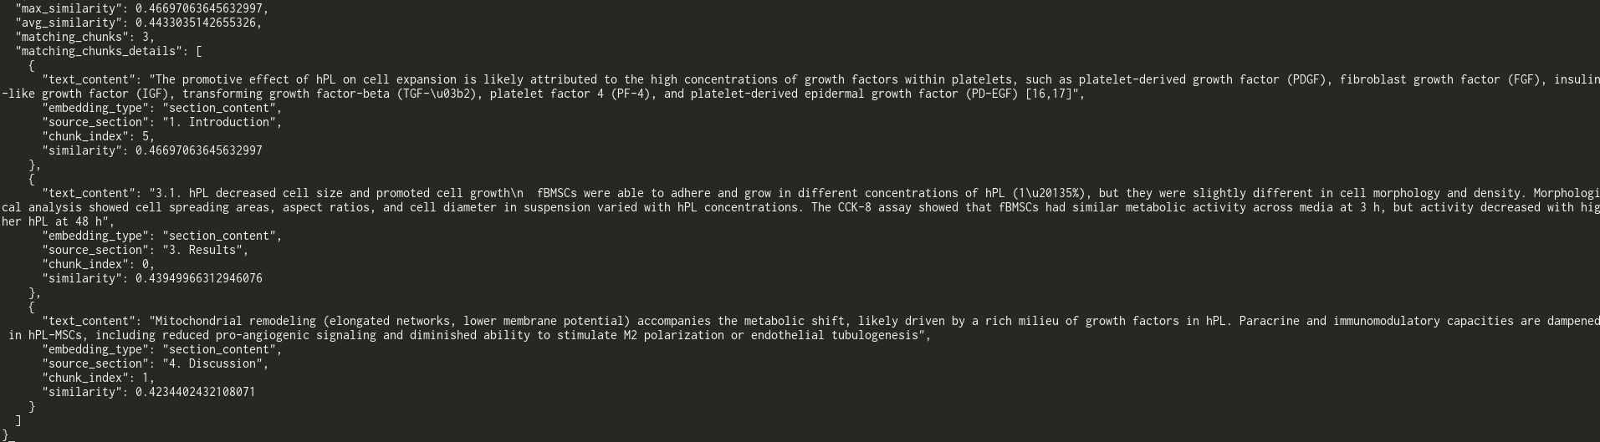

Slide 16
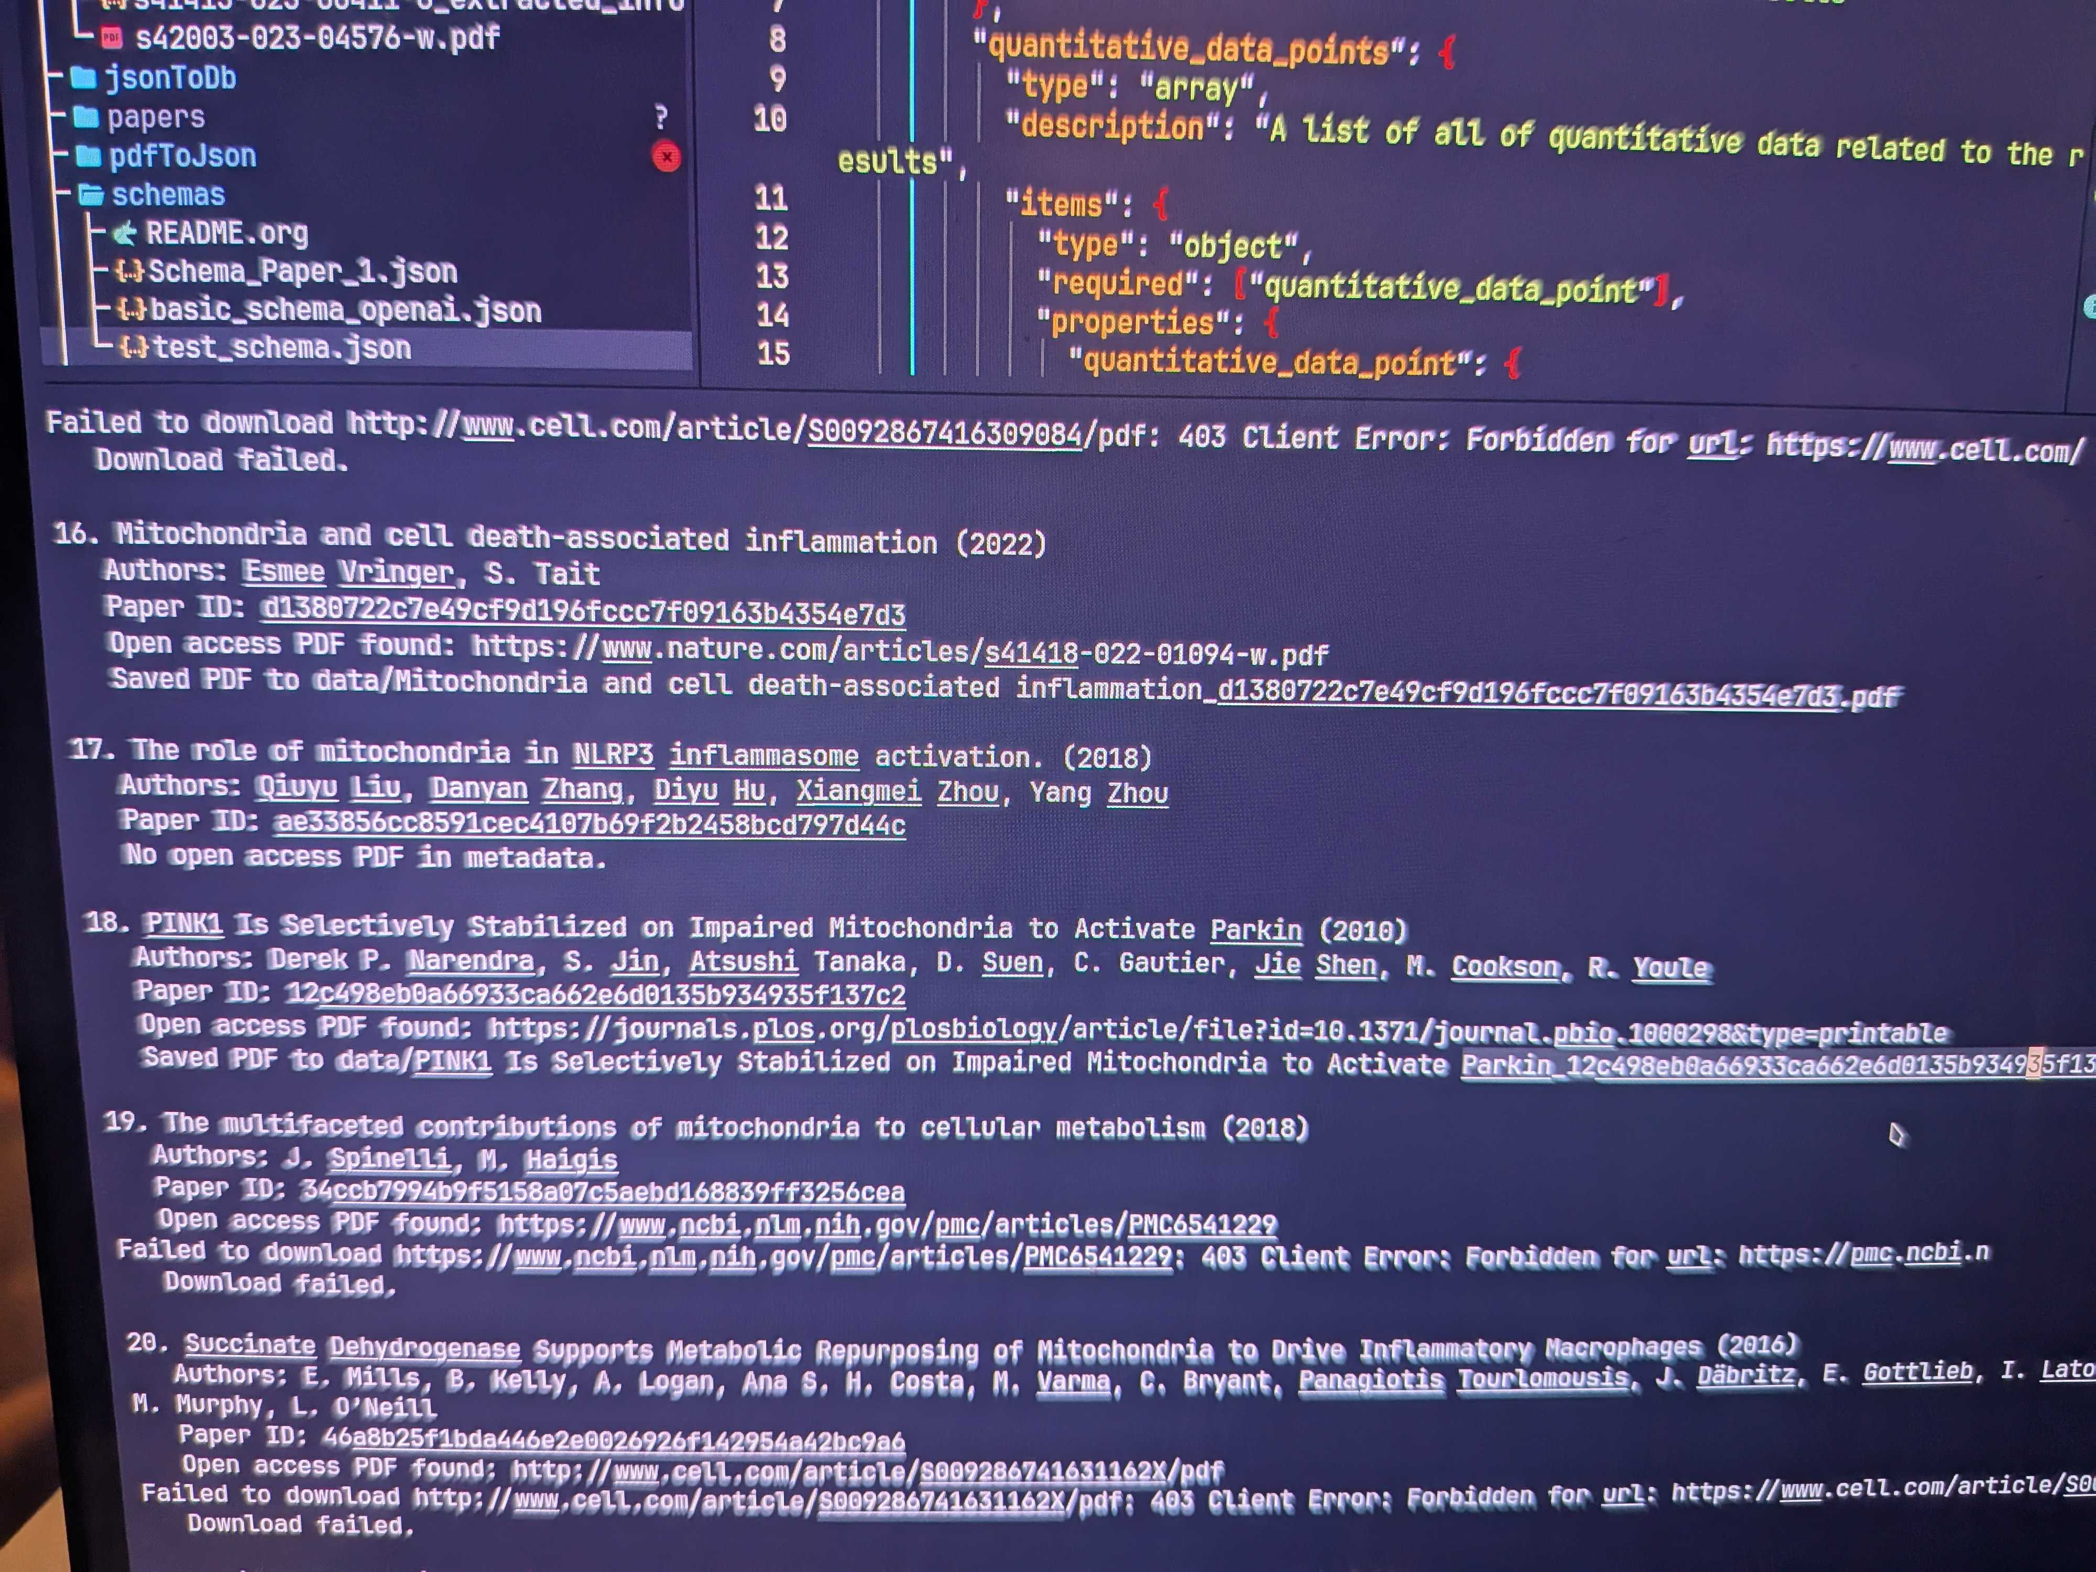

Slide 17
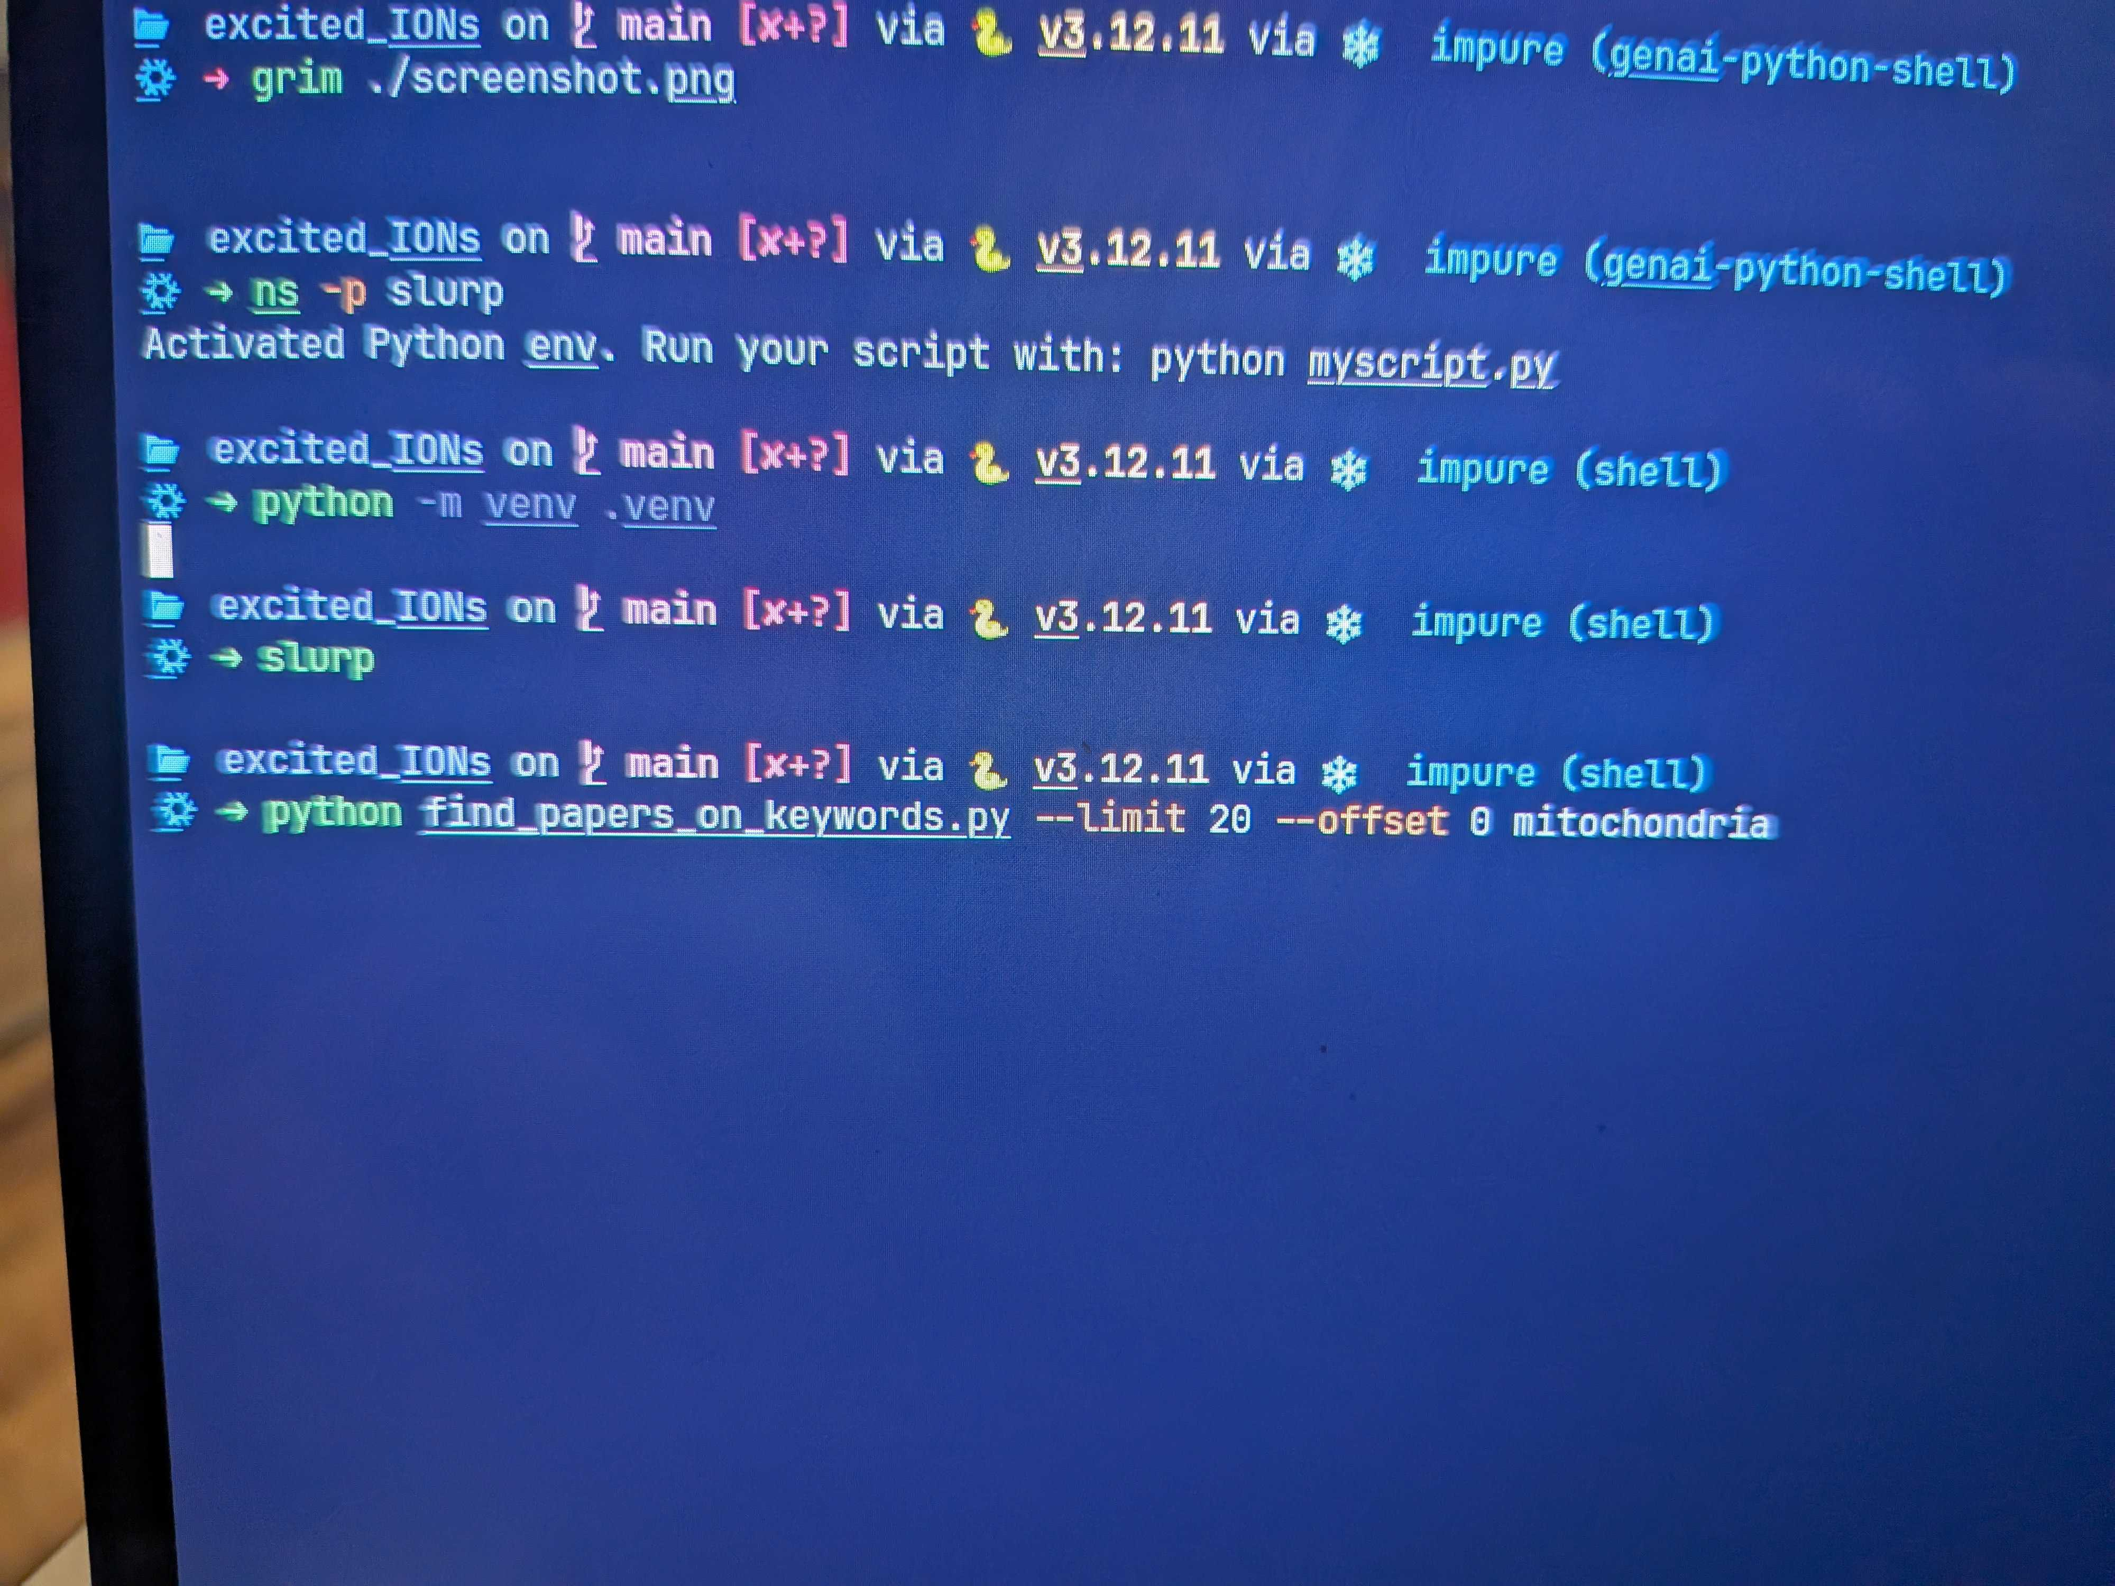

Slide 18
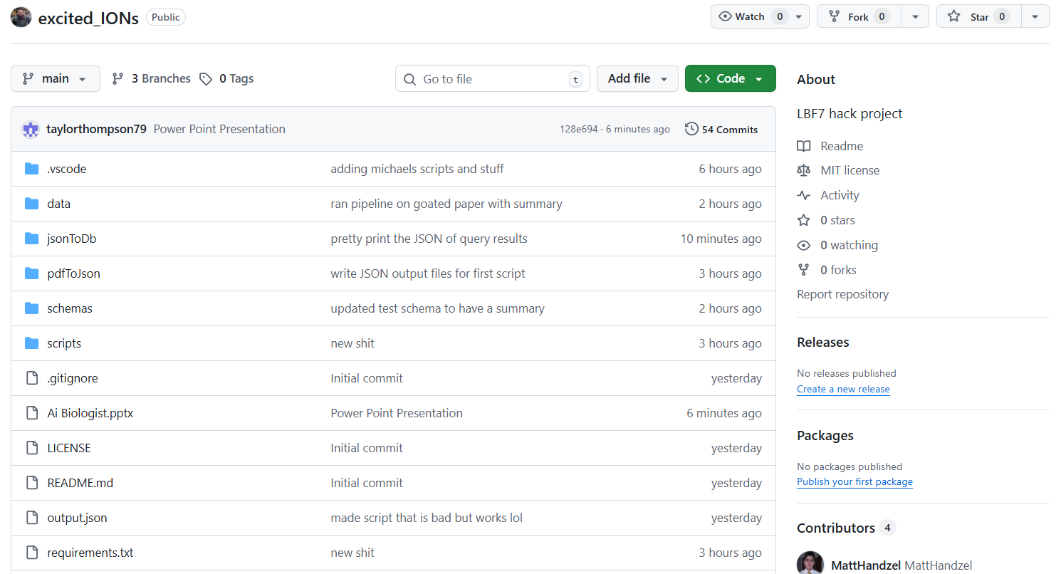

Slide 19
Use Cases
Build Specific Data Base
Automate Data Extraction
Query Database for Experimental Design

